Slide 1
Employee Data Analysis using Excel
STUDENT NAME: M. MARY PRIYA
REGISTER NO: 2213391036026 46450B547C526C5A6234A5EADA383C98.
DEPARTMENT: COMMERCE
COLLEGE : QUEEN MARY'S COLLEGE (AUTONOMOUS)
CHENNAI-04

Slide 2
PROJECT TITLE
Employee Performance Analysis using Excel

Slide 3


AGENDA
Problem Statement
Project Overview
End Users
Our Solution and Proposition
Dataset Description
Modelling Approach
Results and Discussion
Conclusion
3/21/2024 Annual Review

Slide 4

PROBLEM STATEMET
1. Inaccurate assessments of employee strengths and weaknesses 2. Inefficient allocation of training and development resources 3.Limited visibility into team and department performance 4. Difficulty identifying high-potential employees for growth opportunities - Inadequate data-driven decision making for promotions, bonuses, and termination.

Slide 5

PROJECT OVERVIEW
The Employee Performance Analysis and Development System aims to design and implement a comprehensive, data-driven solution to evaluate, develop, and retain top talent within the organization. This project will leverage advanced analytics, machine learning, and HR best practices to provide actionable insights, improve employee engagement, and drive business outcome.
.

Slide 6

WHO ARE THE END USERS?
1. Employees: Receive feedback, set goals, and track progress. 2. Managers Evaluate: performance, provide feedback, and develop team members. 3. HR Professionals: Administer performance management processes, analyze data, and recommend improvements. 4. Leadership : Make data-driven decisions on talent development, succession planning, and organizational strategy. 5. Training and Development Teams Identify: skill gaps and create targeted training programs. 6. Talent Acquisition Teams: Inform hiring decisions with insights on high-performing profiles. 7. Business Unit Heads: Align employee performance with departmental objectives and goals.

Slide 7

OUR SOLUTION AND ITS VALUE PROPOSITION
Conditional formating : Missing value Fliter : Remove Pivottable : Summary Graph : Data

Slide 8
Dataset Description
EMPLOYEE DATA SET = Kaggle 26 features I am use only 9 features because l m analyise employees performance Such as 1.Employee id -id no 2. Name - First and last name 3. Employee Data - Active status 4 . Employee Type -Fulltime ,or contract bases 5. Employee Classification -Full time, part time. 6.Gender -Male , Female

Slide 9
5. Employee Classification -Full time, part time. 6.Gender -Male , Female
7.Performance score - Full meets, 8.Current Employee rating -1 to 5for our performance based 9. Performanc level -Very High, High, Medium,

Slide 10

THE "WOW" IN OUR SOLUTION
PERFORMANCE LEVEL
=IFS(Z2>=5, "VERY HIGH",Z2 >=4, "HIGH", Z2>=3, "MED", "TRUE", "LOW")
3/21/2024 Annual Review
10

Slide 11
MODELLING
DATA COLLECTION
1.Naan muthalvan dashboard 2. Download to system
FEATURE COLLECTION
1. Select only 9 features . Such as. *Employee id,*Name,*Employee data,*Employee type,*Employee classification,*Gender,*Performance score,*Current Employee rating,*Performance level, and identify saperately.
11

Slide 12
DATA CLEANING
PIVOT TABLE
1.Identify missing values 2. Flitering missing values
Pivot table helps to create chart, diagram easily. It included rows, coloum, flitering,etc.
PERFORMANCE LEVEL
VISUALISATION
Performance leavel bases on two columns. There are. 1. Performance score 2. Current Employee rating
Visualization refers to final results of the analysis.

Slide 13
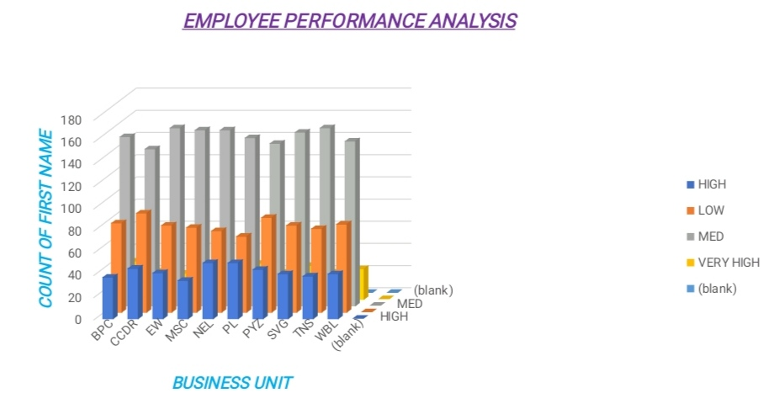
RESULTS
ALL EMPLOYEE PERFORMANCE ANALYSIS
13

Slide 14
conclusion
Employee Performance Analysis is a crucial tool for organizations to evaluate and enhance individual and team performance, driving business growth and success. By providing actionable insights, it enables data-driven decisions, improves employee engagement, and fosters a culture of continuous improvement."

Slide 15
THANK YOU

